Slide 1
Figure 1
**
**
**
**
(a)
**
(b)
**
**
**
**
**

Slide 2
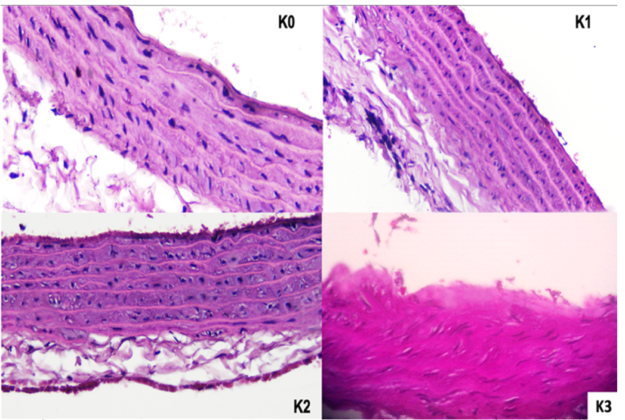
Figure 2
(b)
**
(a)
**
**

Slide 3
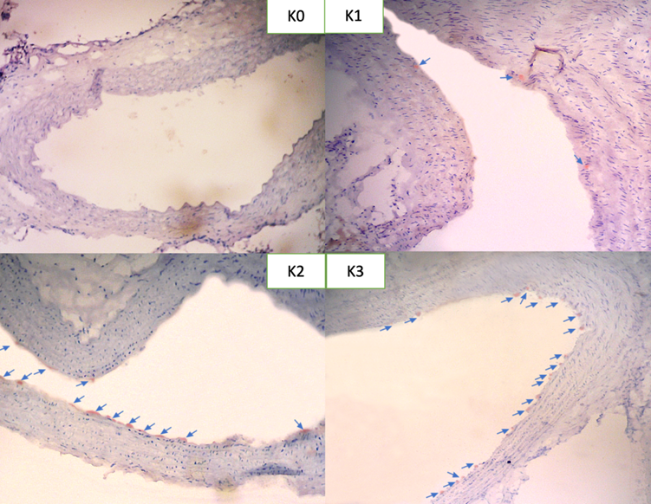
Figure 3
(a)
(b)
**
**
**
**

Slide 4
Figure 4
(a)
**
(b)
**
(c)
**
(d)
*

Slide 5
Figure 5
**
**
(a)
**
(b)
**
**
(c)
(d)
**
**

